Slide 1



Breast Cancer Detection
Team 2

Slide 2
OVERVIEW
01
02
03
Calculating the Pearson Correlation Coefficients
Dataset Selection
02
03
Removing Outliers
04
05
06
Data Visualization and Normalization
Logistic Regression Model Training and Prediction
Model Evaluation

Slide 3


01
Dataset Selection
The first step of the research involves choosing the dataset on which we worked.
Our dataset is about the breast cancer has 5 futures (mean radius, mean texture, mean perimeter, mean area, mean smoothness)

Slide 4
02
Removing the outliers
The Empirical Rule states that 99.7% of the data falls within three standard deviations away from the mean.
We used the z-score method to remove the data points that are more than three standard deviations away from the mean.

Slide 5
03
Calculating the Pearson Correlation Coefficients
We chose the features that are not correlated which helps in:
Avoiding Redundancy: Independent features ensure that you are not duplicating information. If two features are highly correlated and contain essentially the same information, one of them is redundant. Therefore can help keep the model as simple as possible while maintaining predictive accuracy.

Slide 6
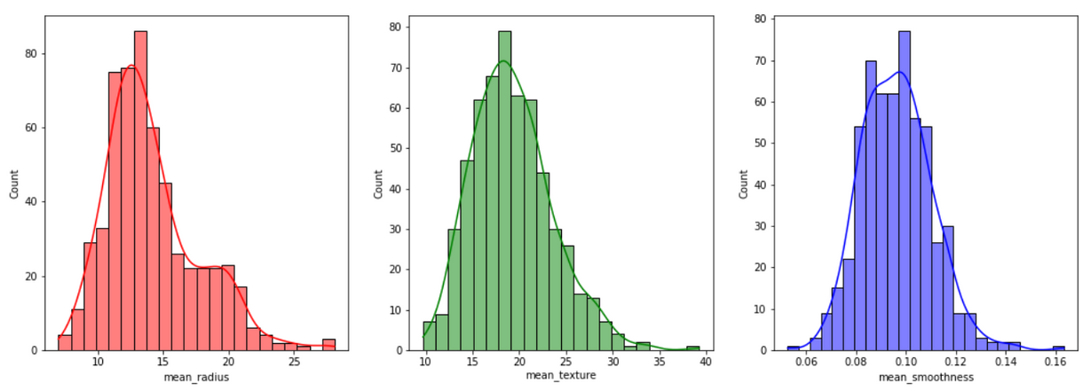
04
Data Visualization and Standardization
Subsequently, the selected data is normalized by subtracting the mean and dividing by the standard deviation.
The purpose of standardization is to scale and standardize data, making it easier for machine learning algorithms to process and compare different features with varying scales.

Slide 7
05
Logistic Regression Model Training and Prediction
The dataset is divided into training and testing sets using a 80-20 split.
A logistic regression model is initialized, and it's trained on the training data.
The trained model is used to make predictions on the test set.
These predictions are then used for evaluating the model's performance and assessing its ability to classify new data.

Slide 8
06
Model Evaluation
RMSE is calculated to measure the difference between predicted values and actual target values.
The accuracy score is determined to assess the model's overall classification performance. In our case it was 90% this means that the model has successfully classified most of the data points.

Slide 9
Thank You !

